Slide 1
NYPD Complaints and Crime Statistics
2018 04 19
Haihui Cao
Kenneth Chen
Benjamin Silk

Slide 2
Background:
Data: NYPD Complaint Data Historic
From free government repository via the NYC Open Data portal on NYC.gov
Includes: valid felony, misdemeanor, and violation crimes reported to the New York City Police Department (NYPD) from 2006 to 2016.

Slide 3
Data:
24 features
5.6 million crimes

Slide 4
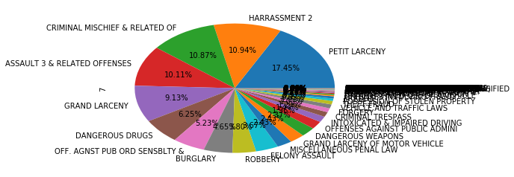
Q. What are the most frequent crimes over 10 years in New York?
The most frequent crimes between 2006 – 2016
PETIT LARCENY 688005
HARRASSMENT 2 431275
CRIMINAL MISCHIEF & RELATED OF 428688
ASSAULT 3 & RELATED OFFENSES 398708
GRAND LARCENY 359811
DANGEROUS DRUGS 246411
OFF. AGNST PUB ORD SENSBLTY & 206066
BURGLARY 183337
ROBBERY 149707
FELONY ASSAULT 144699

Slide 5
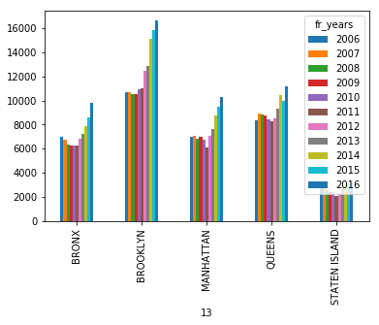
Q. How does ‘Harassment’ complaints relate to each year?
‘HARASSMENT 2’ statistics by city from 2006 to 2016
BROOKLYN 137079
QUEENS 100964
MANHATTAN 84029
BRONX 79179
STATEN ISLAND 30024
‘HARASSMENT 2’ crimes in each city with respective year

Slide 6
Q. How long does it take to close the crime?
Total minutes taken
5.0 527289
10.0 364559
15.0 233072
0.0 222278
30.0 213119
20.0 119527
60.0 105768
2.0 78363
1.0 68354
3.0 59321
4.0 48384
6.0 44470
7.0 43223
120.0 41029
Crimes that takes 547 days to close
27435 BURGLARY
143061 HARRASSMENT 2
224522 OFF. AGNST PUB ORD SENSBLTY &
244856 THEFT-FRAUD
933785 GRAND LARCENY
1806860 GRAND LARCENY
1932161 HARRASSMENT 2
2027358 GRAND LARCENY
2334642 GRAND LARCENY
2635346 THEFT-FRAUD
2970653 GRAND LARCENY
3684636 OTHER OFFENSES RELATED TO THEF
3954257 OFF. AGNST PUB ORD SENSBLTY &

Slide 7
New York (Manhattan) Crimes that take more than 546 days to close

Slide 8
New York (Manhattan) Crimes that take more than 546 days to close

Slide 9
Which year or month has the most crimes? Are the crimes related to seasons or weather?
The monthly average of crimes from 2006 to 2016.

Slide 10
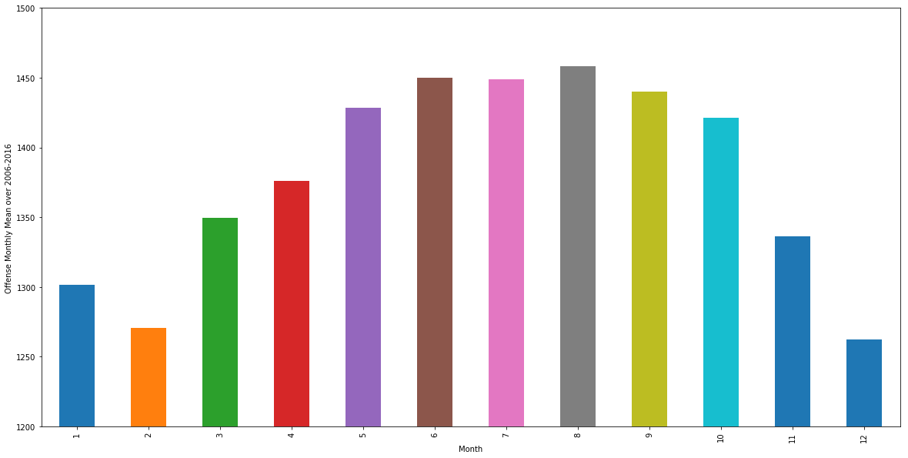
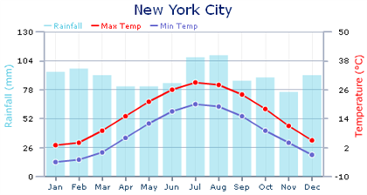
Which year or month has the most crimes? Are the crimes related to seasons or weather?
a)
a) The mean crimes of each month from 2006 to 2016. b) The average temperature of New York City each month.
The correlation of crimes to average temperature over months is 0.95
It seems the crimes are correlated to temperature except January.
b)

Slide 11
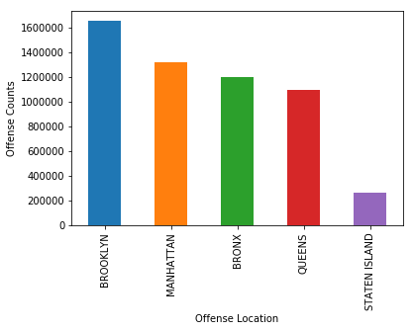
How are crimes correlated to demographic and population data geographically?
Area | Crimes | population_2010 | population_per_acre
BROOKLYN | 151919 | 2504700 | 55.3
MANHATTAN | 120960 | 1585873 | 108.5
BRONX | 111824 | 1385108 | 51.4
QUEENS | 99082 | 2230722 | 32.1
STATEN ISLAND | 24063 | 468730 | 12.5

Slide 12
Top 10 most frequent crimes:

Slide 13
Crimes counts over 2006-2016:
RPT_DT
2006 536263
2007 536261
2008 528317
2009 511293
2010 507730
2011 496945
2012 502701
2013 495662
2014 489825
2015 477394
2016 478752
Freq: A-DEC, Name: OFNS_DESC, dtype: int64

Slide 14
What are the most frequent crimes? Does this differ by borough

Slide 15
Does crime fluctuate over time? What are the crime trends from 2006-2016?

Slide 16
Thank you
Future: Data Science Fights against Crimes

